Slide 1
Lane Following Robot

Slide 2
Let’s have fun with the Robot
python manual_control.py

Slide 3
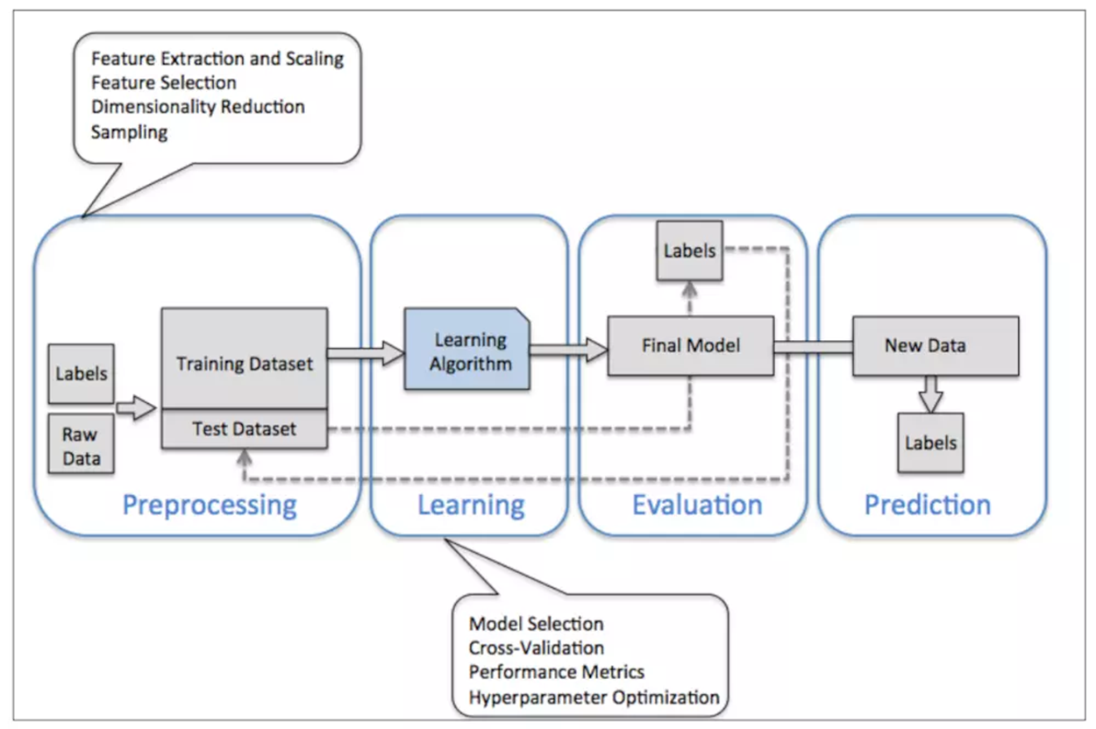
Typical Work Flow

Slide 4
Get Raw Data
Duration 10 minute

Slide 5
Preprocessing and Train – Validation Split
Duration 30 minute

Slide 6
Train and Validation
Duration 30 minute

Slide 7
Predictions

Slide 8
Let’s AI Drive the Car

Slide 9
Questions?

Slide 10
My Questions:
Q1: What is the different between virtual world and real environment?
Q2: What is the benefit of testing in virtual world?
Q3: What happen if you directly transfer the prediction model to a robot?
Notes:
Q1 – Wind, friction, machine breakdown, Sun Light
Q2 – cost effective
Q3 -

